Slide 1
Enterprise Architecture

Slide 2
Definition
Enterprise architects
are concerned primarily with innovation, security, and optimization.
are commonly involved in the solution life cycle.
concerned with the technology mesh across the entire enterprise and they delegate their recommended solutions to others to implement.
Software architects:
have a much more micro view than EAs. They define best practice standards and provide technical guidance and leadership for dev teams.
Architecture
Model 1: single file: View➔DB/Model➔Business & control code (Hierarchy approach)
Model 2: Classic MVC
Three Tier / Web MVC (Problem over here is the duplication of business logic if the new type of end user device is added)
Service Oriented Architecture: View➔Controller➔Service➔Model (Here service handles the business logic and is not repeated)
DDD: Core domain or business logic is separate from other modules. Clear separation of concern
SOA: View➔controller➔Serivce➔Domain➔Persistence ➔Should be able to describe each layer
Adv: Business logic is independent of technology used
Adv: Business Easy to write, test, and modify

Slide 3
Framework
Inversion of Control: Don’t call us, we’ll call you
Imperative programming
Code defines the logic
Execution is done line by line
Hard to test and debug
Declarative programming
Defines what to do not how to do
Service Helpers
Transactions, security, Logging, AOP
Object Relational Mapping
Identity, Attributes, Associations, Meta Data
Separation of Concern
Different Architectural layers
Plain old java objects
Java bean standard
Separate business from technology

Slide 4
Hibernate:
Framework for the persistence layer
Object Relational Mismatch (That is why Object Model != Relational Schema that)
This means that there is no clear way to translate all the concepts from OO programming to Relational Database Concept and vice-vers
Objects are instantiations of classes and have identity ➔ in RDMS table name and PK are used to identify a row in a table
Objects have associations ➔ RDMS has FK and links table
Objects has inheritance ➔ RDMS does not have such relation
Data can be access by following the objects associations ➔ Data can be accessed using queries and joins
Java Persistence Possibilities
Store procedures
SQL
iBatis SQL Maps
Entity Beans
ORM
It lets one to focus on object models
Supports DDD
Objects are automatically loaded as needed
Changes to objects can automatically be stored in the database
Adv of ORM
Productivity ➔few lines of persistence code
Maintainability ➔mapping is defined in one place
Performance ➔caching and optmized
JPA is a Java Standard for ORM persistency
3 ways to Hibernate
using xml mapping files
using annotations
JPA using annotations

Slide 5
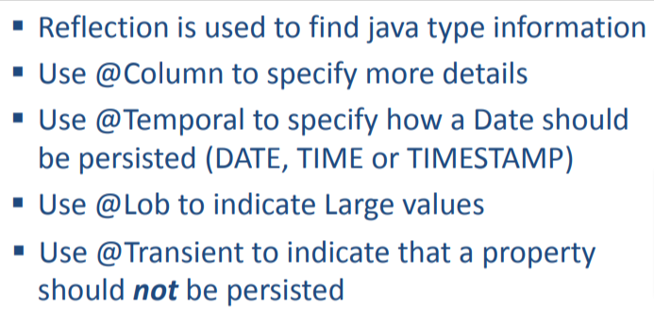
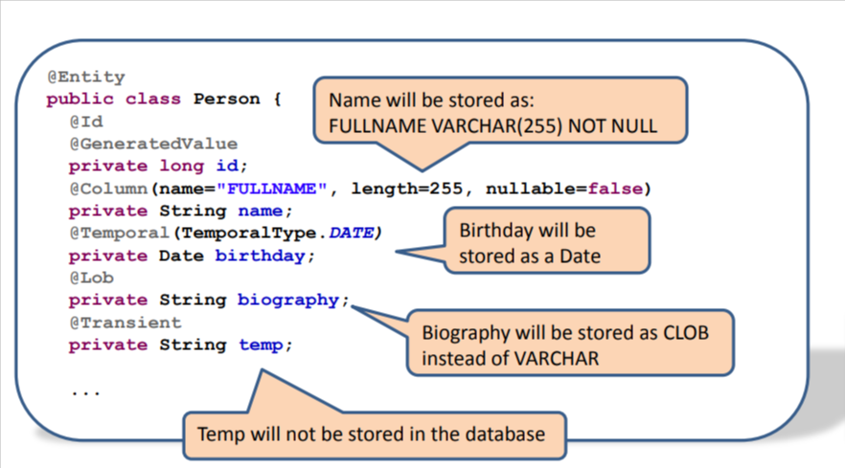
Spring framework
Aims
Maker enterprise application development easy by following
POJO based programming
All codes in java objects
Promotes OO principles
Simple to understand
Simple to refactor
Simple to unit test
Separation of concern
Flexibility
Core of Spring
Dependecy Injection (DI),
Spring instantiates objects and wires them together
Aspect-Oriented Programming (AOP)
Separation of cross cutting concerns (plumbing code) from the business logic code
Weaving separate business logic and enterprise services together
Enterprise Service Templates
JDBC, JMS, JavaMail, Hibernate
Advantages of Spring
It make application simple, flexible and separation of concern
Disadvantage of Spring
It is yet another framework to learn
Spring is not a java EE standard
The xml file of spring can become very complex

Slide 6
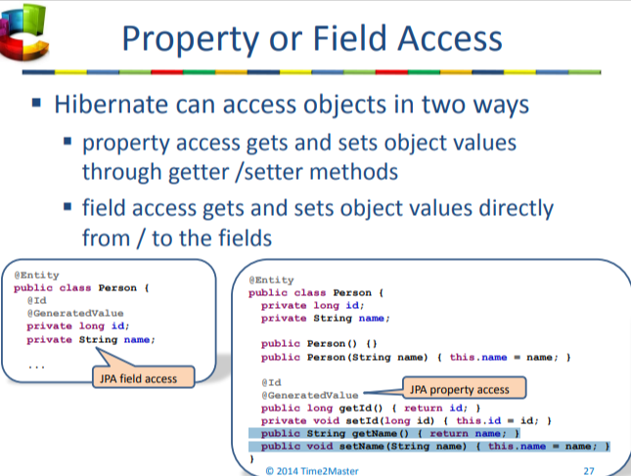
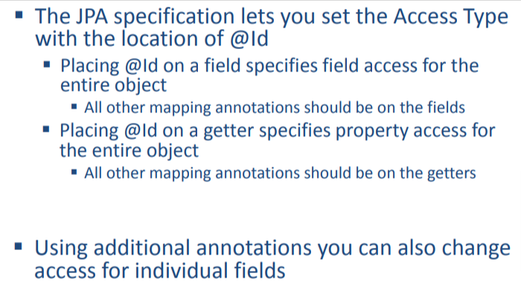
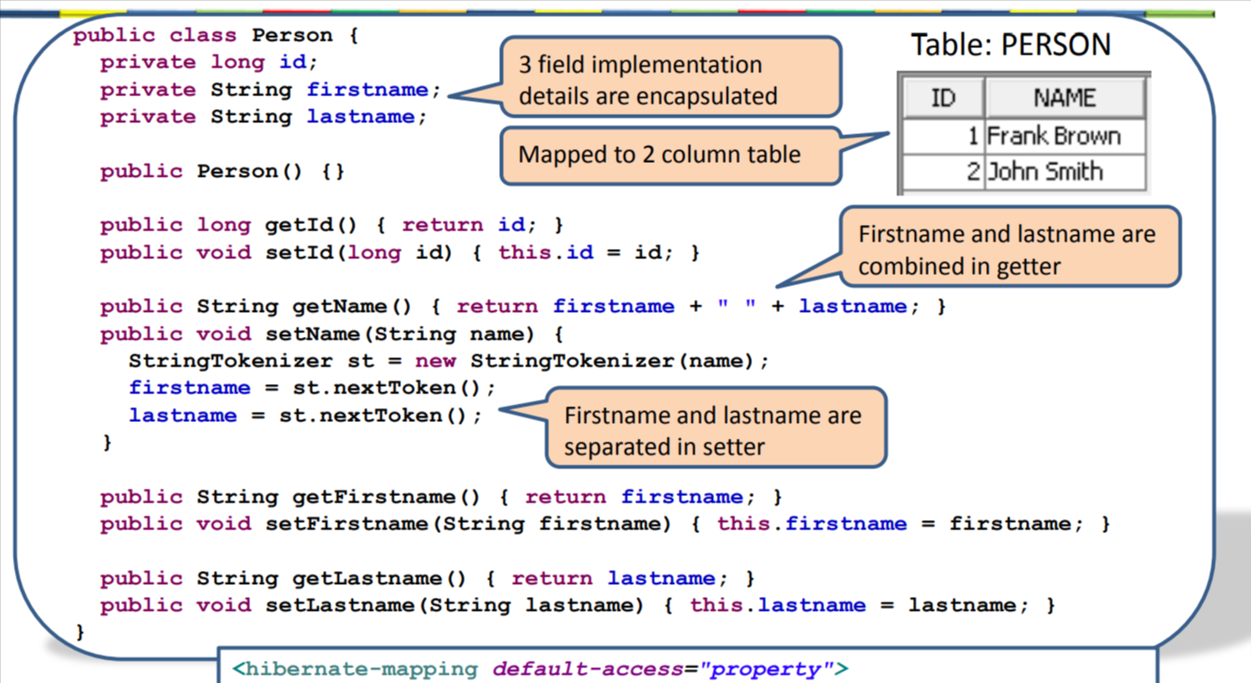
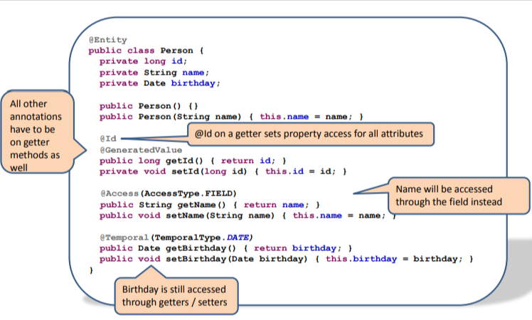
Note: here four field are creates Id, firstName, lastName, and Name. FirstName and LastName are set via Name setter. While table field are created via getter method Also, for property based both getter and setter are required however setter can exist along but getter cannot
@Entity(name=“My_Table”)➔My_Table is a logical name that will be used by HQL

Slide 7
Differences between field access vs property access
Value access:
Access directly by field by putting @Id before field
Does not require getter or setter method for value injection
The injection process cannot be debugged via getter or setter
Property access
Access via getter or setter by placing @Id before property
The injection process can be debugged via getter or setter
Data persistence can be alter by overriding the setter method and hence strict encapsulation may be violated to some extent

Slide 8
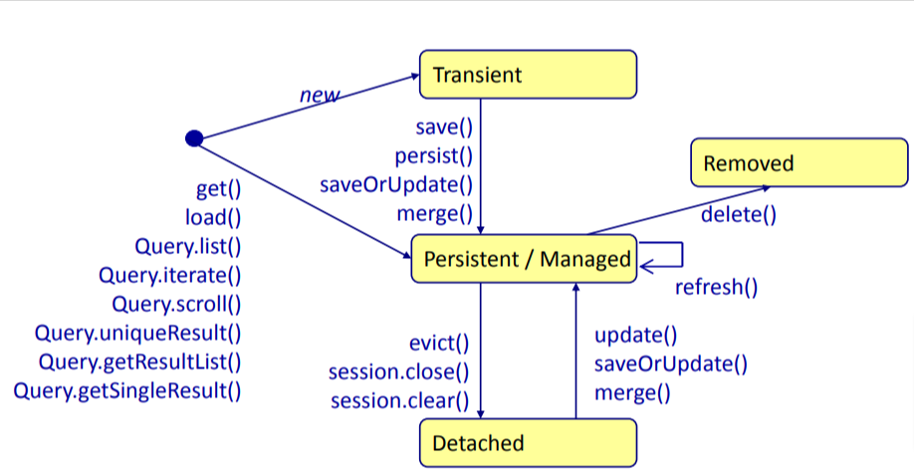
Hibernate: Life cycle of an Entity
Hibernate Persistence context
Manages the entities
Guarantees that managed entities will be saved in the database
Tracks changes until they are pushed
Works like a cache
Transient Entity: has no DB identity
Managed Entity: has DB identity
Detached Entity: has DB identity but not managed by current persistence context
Removed Entity: ref entity removed from database
Do not use @Temporal when data type is LocalDate or LocalTime. It is ok to use for Datatype Date

Slide 9
Session
Create
Session.save() ➔eager, always returns Identity
Long id=(long)session.save(object);
session.persist() ➔lazy, wait until needed and thus returns void
session.persist(object);
Retrieve
Session.get() ➔eager, retrieves value right away
(Object)session.get(Object.class, PK)
session.load() ➔lazy, it provides proxy and does not retrieve the objects value until they are first needed
(Object)session.load(Object.class, PK)
Update
Session.update➔ this is explicit update, can be used to re-attach if the entity is in detached state
Update() will throw exception when re-attaching an object with the same id as already managed object. So solution is to use: session.merge()
Create/Update
Session.saveOrUpdate()
Session.merge()
Delete
session.delete()
[using load and delete will take 2 DB communication] ➔Eager mode
[using get and delete will take 1 DB communication] ➔Lazy mode
Cache related
Session.refresh() ➔rollback the state of the persistence context
Session.flush() ➔Will save all pending object before transaction commit

Slide 10
When are changes flushed?
When an explicit session.flush() is called
When a transaction is committed
When a query to database is executed inside a transaction
Proxy is counterfeit
Implicit update:
When a changes in the managed entities are made then those changes are automatically saved on commit()
Explicit update:
Changes are saved when you explicit call the session.update() method.
If the object is in detacted state, then the object needs to re-attached and save it. This called explicit update
For entity that has generated value “save” and “persist” happens immediately. Here persist acts as an eager operation
Once session is out, object will be in detached state
Something changed in managed object, changes does not go the database immediately. However, before context runs CreateQuery it runs commit of all dirty changes
Session.refresh() clears the changes you made in the objects
Merge does not behave like save(), update(), and saveOrUpdate() ▪ The object you pass in to merge never becomes part of the persistence context (is not managed) ▪ Instead merge returns an different object representing the same entity (which is managed). In session.merge, always use ref coming back from merge
When does Hibernate access the DB
On persist() ➔to retrieve the unique identity key
On commit()

Slide 11
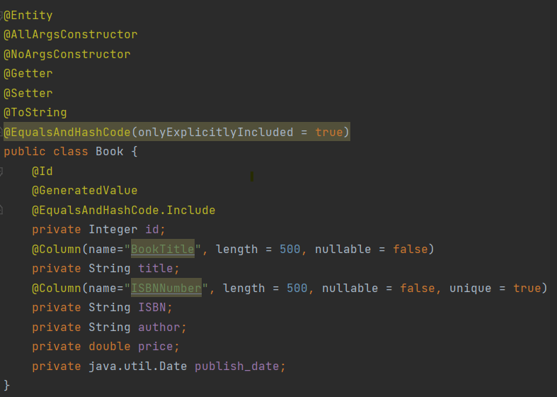
Model Annotations

Slide 12
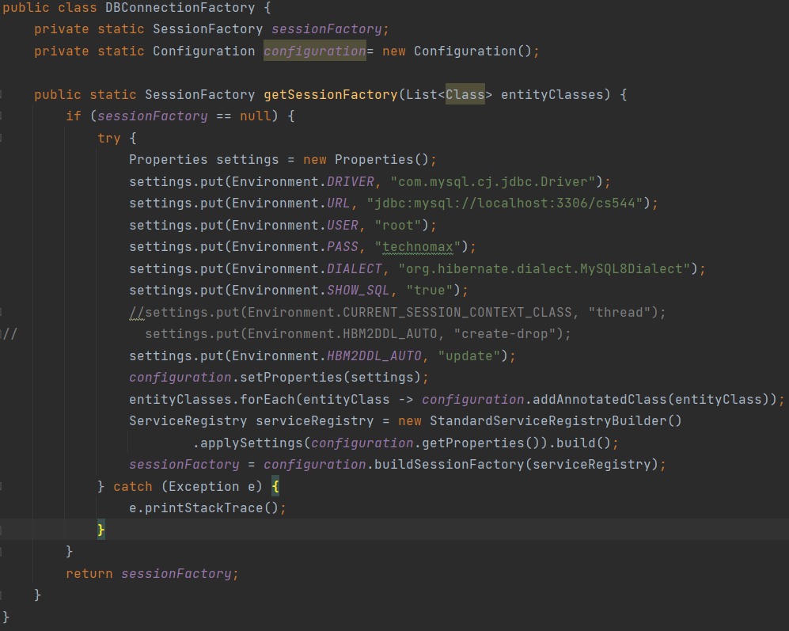
DB Connection Factory

Slide 13
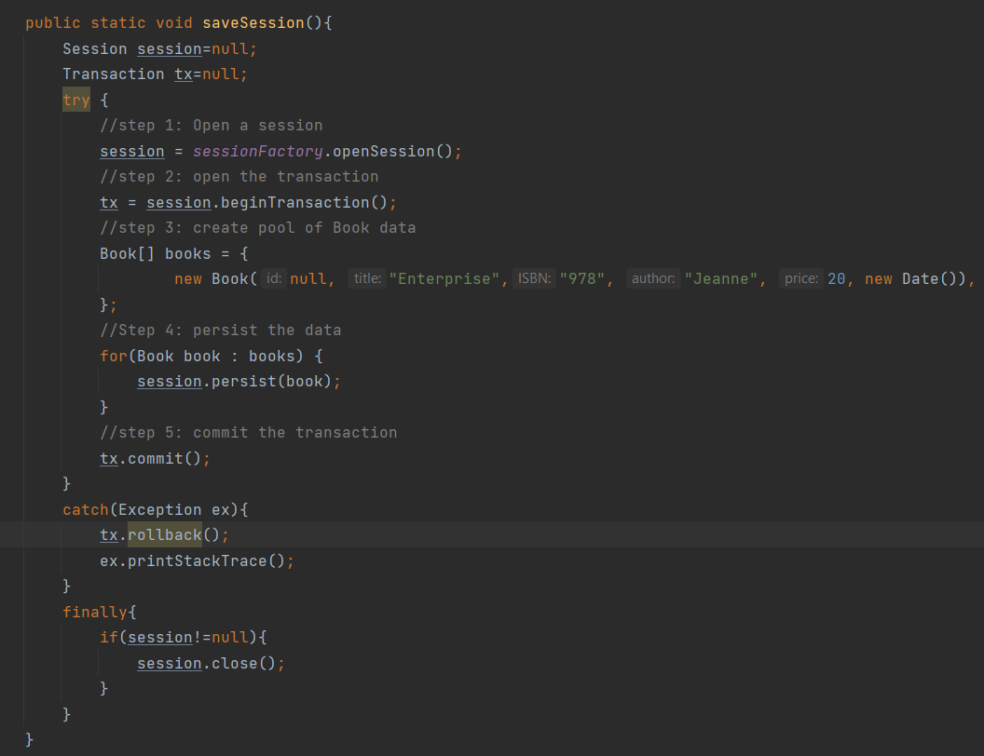
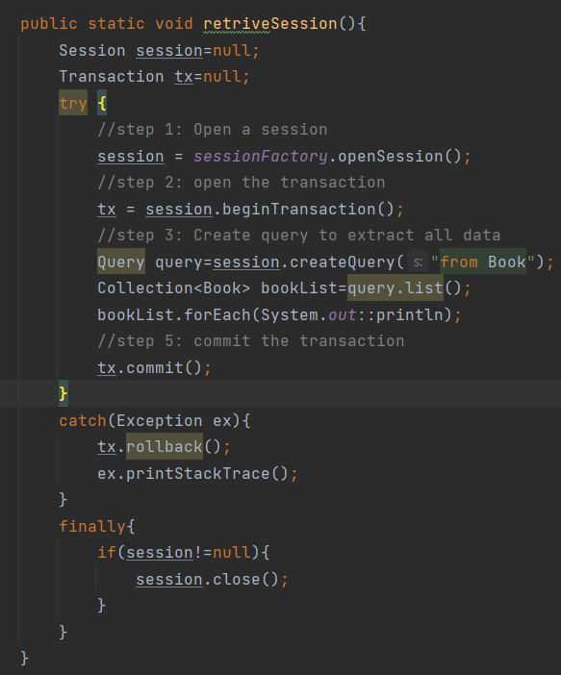
Save and Retrive all Mechanism

Slide 14
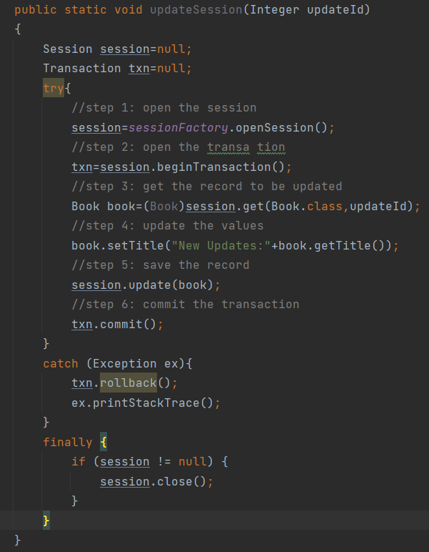
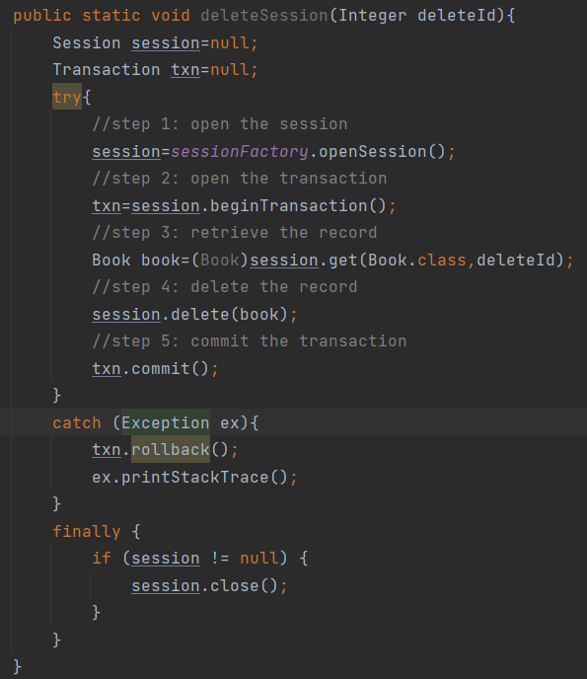
Update and Delete Mechanism

Slide 15
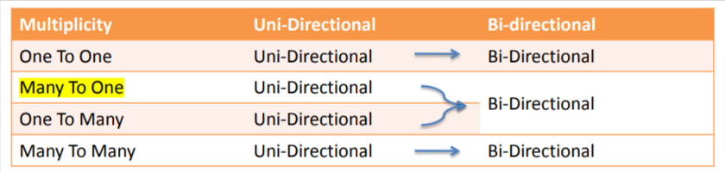
Association Mapping
Uni-Directional➔OneToMany
At Source: private List<Destination> dests= new ArrayList();
Bi-Directional➔OneToMany
At Source: private List<Destination> descs= new ArrayList();
At Dest. Private Source source;

Slide 16
OneToMany➔Uni: (default is join table)
Source:
@OneToMany
private List<Target> targets= new ArrayList();
Result: Create third table named: source_target
OneToMany➔Uni: with @JoinTable
Source:
@OneToMany
@JoinTable(name=“<table_name>”, joinColumn={@JoinColumn(name=“<src_id>”}, inverseJoinColumns={@JoinColumn(name=“<dest_id>”})
private List<Target> targets= new ArrayList();
Result: Create third table named: source_target
OneToMany➔Uni with FK provided via JoinedColumn
Source:
@OneToMany
@JoinedColumn(name=“source_id”)
private List<Target> targets= new ArrayList();
Result: Target table created with FK as source_id
ManyToOne➔Uni: (Default is join column)
Source:
@ManyToOne
private Target target;
Result: Source table created with FK as target_id (May result in optional fk)
ManyToOne➔Uni: with FK provided via JoinedColumn
Source:
@ManyToOne
@JoinColumn(name="target_id")
private Target target;
Result: Source table created with FK as target_id (May result in optional fk)
ManyToOne➔Uni: with @JoinTable (To avoid optional fk)
Source:
@ManyToOne
@JoinTable(name=“<table_name>”)
private Target target;
Result: New Joined Table created

Slide 17
ManyToOne/OneToMany ➔Bi (No Mapped By)
Source:
@OneToMany
@JoinColumn(name="source_id")
private List<Target> targets= new ArrayList();
Target:
@ManyToOne
@JoinColumn(name="target_id")
private Source source;
Result: Created Target table with field, source_id and target_id
ManyToOne/OneToMany ➔Bi (With Mapped By)
Source:
@OneToMany(mappedBy = "source")
private List<Target> targets= new ArrayList<>();
Target:
@ManyToOne
@JoinColumn(name="source_id")
private Source source;
Result: Create Target table with FK source_id
MappedBy is used for Bi-Directional Mapping
MappedBy specifies that this side is not owing side
MappedBy and @JoinedColumn cannot come together
The many side of one-to-many / many-to-one bidirectional relationships must be the owning side, hence the mappedBy element cannot be specified on the ManyToOne annotation.
The relationship owner is the entity that possess the foreign key. From the database point-of-view relationship owner is the entity that is persisted to table that have foreign key column (same for bidirectional one-to-one).
Cascade is a convenient feature to save the lines of code needed to manage the state of the other side manually.

Slide 18
OneToOne➔Uni (Basically shared primary key (This is not supported by JPA)
Source:
@OneToOne
private Target target;
Result: Create source table with target_id as fk
OneToOne➔Bi
Source:
@OneToOne
@JoinColumn(name=“target_id”)
private Target target;
Target:
@OneToOne(mappedBy=“target”)
Private Source source;
Result: Create source table with target_id as fk
OneToOne➔Uni by Share primary key
Source:
@OneToOne
@PrimaryKeyJoinColumn
Private Target target
Result: Source PK is reflected in Target PK
OneToOne➔BI by Share primary key
Source:
@OneToOne
@PrimaryKeyJoinColumn
Private Target target
Target:
@Id
@GeneratedValue(generator="myGenerator") @org.hibernate.annotations.GenericGenerator( name="myGenerator", strategy="foreign", parameters=@Parameter(name="property", teavalue="customer") )
Private Integer id;
@OneToOne
@PrimaryKeyJoinColumn
Private Source source;
Result: Source PK is reflected in Target PK

Slide 19
ManyToMany➔Uni
Source:
@ManyToMany
@JoinTable(name=“source_target”, joinColumns={@JoinColumn(name=“source_id”)},
inverseColumns={@JoinColumn(name=“target_id”)})
Private List<Target> target=new ArrayList();
Result: Third table named source_target is created with column as source_id and target_id
ManyToMany➔Bi (@JoinTable needs to map the existing database design. Be careful)
Source:
@ManyToMany
@JoinTable(name=“source_target”, joinColumns={@JoinColumn(name=“source_id”)},
inverseColumns={@JoinColumn(name=“target_id”)})
Private List<Target> target=new ArrayList();
Target
@ManyToMany(mappedBy=“target ”)
Private List<Source> source= new ArrayList();
Result: Third table named source_target is created with column as source_id and target_id
Association Cascades
By default hibernate does not cascade
During session.update, session,persist, session.delete
Use cascade=CascadeType. ➔attribute for imposing cascades
For Hibernate Cascade ➔ref. page 42
Delete Orphan
@OneToMany(mappedBy = "patient", orphanRemoval = true)

Slide 20
Collection Mapping
There are four types of collection ref
Bags, Sets, Lists, Maps and these are splitted into Indexed and Non-Indexed Collections
By default List is a index data structure
Hibernate requires Program to Interface (P2I) ➔Best practice
Bags ➔Most basis, eg. Java.util.collection (When there is no sequence column then use collection)
No inherent order, non-indexed collection, and can contain duplicates
Source:
@OneToMany(mappedBy=“instance”)
Private Collection<Dest> dests=new ArrayList();
Destination
@ManyToOne
Private Dest instance;

Slide 21
Set
Does not contain duplicates, is non-indexed, but still has no inherent order
Source:
@OneToMany(mappedBy=“instance”)
Private Set<Dest> dests=new HashSet();
Destination
@ManyToOne
Private Dest instance;
List
Has an inherent, arbitrary order, indexed and can contain duplicates. If list does not contain sequence column for order then it may be issue in ordering
Source:
@OneToMany(mappedBy=“instance”)
@OrderColumn(name=“sequence”)
Private List<Dest> dests=new ArrayList();
Destination
@ManyToOne
Private Dest instance;
One to Many Bi-Directional List
Source:
@OneToMany
@JoinColumn(name=“ref_id”)
@OrderColumn(name=“sequence”)
Private List<Dest> dests= new ArrayList();
Destination:
@ManyToOne
@JoinColumn(name=“ref_id”)
Private Destication instance;

Slide 22
Map (Key part of table column)
Has unique key, no inherent order, and are indexed collection
Can be mapped at part of value entity class and not part of value entity class
Source:
@OneToMany(mappedBy=“instance”)
@MapKey(name=“col_name”)
Private Map<Dest> dests=new HashMap();
Destination
@ManyToOne
Private Dest instance;
Map (Separate Key)
Has unique key, no inherent order, and are indexed collection
Can be mapped at part of value entity class and not part of value entity class
Source:
@OneToMany(mappedBy=“instance”)
@JoinColumn(name=“ref_id”)
@MapKeyColumn(name=“col_name”, nullable=true)
Private Map<Dest> dests=new HashHap();
Destination
@ManyToOne
@JoinColumn(name=“ref_id”, updatable=false, insertable=false)
Private Dest instance;

Slide 23
Order By:
Collections mapped as list can not be re-ordered as they already have a specific order
Sets, Bags, and Map can be ordered when retrieving a collection and is done by the database
Source:
@OneToMany(mappedBy=“dest”)
@OrderBy(“size desc”)
Private Set<Dest> dests= new HashSet();
Destination:
@ManyToOne
Private Source dest;

Slide 24
Inheritance Mapping
Is-a relationship
Relational database does not have is-a relationships
3 ways to emulate inheritance
Polymorphism
Ability of subtype to appear and behave like its supertype
A polymorphic query is a query for all objects in a hierarchy, independent of their subtype
3 Ways to map inheritance
Single table per Hierarchy
De-normalized but fast polymorphic queries
Joined Tables
Normalized but slow queries
Table per concrete class
Use union over join and all needed columns in each table

Slide 25
Single table Mapping
Discriminator column specifies actual type
Sub class properties added as nullable columns
Simple and easy to implement
Good performance
Nullable column / de-normalized
Table may contain lots of columns
SuperTable
@Inheritance (strategy=InheritanceType.Single_Table)
@DiscriminatorColumn(name=“account_type”, discriminatorType=…)
SubTables
@DiscriminatorValue(“Saving”)
@DiscriminatorValue(“Checking”)

Slide 26
Joined table Mapping
Uses FK constraints on the PK
Normalized schema and view is similar to domain view
Low query performance and insert and update involves multiple steps
Supertable
@Inheritance(strategy=InheritanceType.Joined)
Subtable
No actions needed

Slide 27
Table per concrete class
Uses table per concrete class (non-abstract classes)
Queries are union operation with decent performance
Cannot use identity column generation
Subclass properties cannot use primitive
Supertable
At Table Level
@Inheritance(strategy=InheritanceType.Table_per_class)
At property level
@Id
@GeneratedValue(strategy=GenerationType.TABLE)
Subtable
No actions needed

Slide 28
Summary
If subclasses do not contain a lot of properties ➔single table
If subclasses have many properties ➔joined table
Avoid using table per concrete class unless you do not have any polymorphic associations
Polymorphism means "many forms", and it occurs when we have many classes that are related to each other by inheritance
A polymorphic query is one were we can query on the Parent class and as a result get instances of Parent, LeftChild and RightChild.
Questions like: Explain single table inheritance and mention two adv and dis

Slide 29
Complex Mapping
Secondary tables ➔allow a classed to be mapped to multiple tables
Embedded Classes ➔ allow multiple classes to be mapped into a single table
Composite keys➔ can be made using embedded classes
Immutable entities ➔ entities that never changes

Slide 30
Secondary Tables
Property has to specify table
Can even be used in combination with the single table strategy
At class level
@DiscreminatorValue(“saving”) ➔Optional
@SecondaryTable( name=“SavingAccount”,
pkJoinColumns=@PrimaryKeyJoinColumn(name=“number”, referenceColumnName=“number”)
At property level
@Column(table=“SavingAccount”) ➔ specifies that it should be on SavingAccount table

Slide 31
Embedded Classes
Combines multiple classes in a single table
Useful for tight associations
These classes are considered value classes rather than entity classes
SuperClass: At property level
@Embedded
//For multiple embedded
@AttributeOverrides({
@AttributeOverride(name=“abc1”, column=@Column=“xyz1”)),
@AttributeOverride(name=“abc2”, column=@Column=“xyz2”)),
})
Private <subclass> instance;
SubClass: At class level
@Embeddable (instead of @Entity, and no @id in embeddable)

Slide 32
Composite Keys
Are multi-column primary keys
Need to set by the application
Generally found in legacy system
Also create multi-column FKs
Mapping strategies
Using embeddable class as a composite key
Other mappings (not supported)
FirstClass (no @Entity that is value class)
@Embeddable
<need equals and hashcode method>
Class Name;
SecondClass (at entity class)
@EmbeddedId <at property table>
Private Name name; //<<now name property is replaced by the properties in Name class

Slide 33
Foreign keys to composite ids
In entity class
@EmbeddedId
….
@OneToMany(mappedBy=“owner”)
Private List<Dest> dests=new ArrayList();
In Destination class
@ManyToOne
@JoinColumns({
JoinColumn(name=‘abc1’, referenceColumnName=“xyz1”),
JoinColumn(name=‘abc2’, referenceColumnName=“xyz2”),
})
Private <Source> owner;

Slide 34
Element Collections (Differs from OneToMany – Element Collections is for embeddable classes while OneToMany applies for Entity Classes)
For collections of primitive values or collections of embeddables
Does not make sense from a OO point of view
@Entity class property ➔Default table name is classname_propertyname
@ElementCollection
@CollectionTable(name=‘abc’)
Private List<String> name1=new ArrayList();
@ElementCollection
Private List<Address> name2=new ArrayList(); ➔when address is value object do not use OneToMany. Embeddable is an example of Non-entity.
Map in ElementCollection
@Entity class property ➔Default table name is classname_propertyname
@ElementCollection
@MapKeyColumn(name=“name”)
Private Map<key,<classname>> refs=new HashMap(); ➔Default key column name is propertyname_KEY

Slide 35
Immutable Entities
Once created, does not change
No setters
Sets all fields in the constructor
Gives hibernate field access
@Entity
@org.hibernate.annotations.Entity(mutable=false)

Slide 36
Hibernate Query Language
Hibernate offers several ways to query the DB
Using HQL
Using criteria API
Using Native SQL
HQL understands objects and attributes
HQL understands associations between objects
HQL understands inheritance and polymorphism
Query query=session.createQuery(“from person”)
List<Person> people=query.list();

Slide 37
Using Named Queries
Retrieved a named query by its name
Then use it like any other query
@Entity
@NamedQueries({ @NamedQuery(name="Person.Everybody", query="from Person") })
Public class Person{}
Query query=session.getNamedQuery(“Person.Everybody”)
From Clause
Select clause is optional
HQL keywords are not case sensitive
Class and property names are case sensitive
Polymorphic queries
List accounts = session.createQuery("from Account").list();
Query q = session.createQuery("from java.io.Serializable");
Query q = session.createQuery("from java.lang.Object");

Slide 38
Aliases
Session.createQuery(“from person p”)
Pagination
Query query=session.createQuery(“from person”)
Query.setFirstResult(0);
Query.setMaxResult(50);
Order By
Session.createQuery(“from person p order by p.lastName asc|desc”)
Where clause
session.createQuery("from Person where firstname = 'John'");
session.createQuery("from Person p where p.accounts[0].id = 3");
session.createQuery("from Person p where p.pets['Mimi'].species = 'Cat’”);
Query Parameters
String firstname = "John";
Query query = session.createQuery("from Person where firstname = :first"); query.setParameter("first", firstname);
NOTE: bad to use concatenation because
Probability of SQL injection
Query becomes messy and less readable

Slide 39
Positional parameter
Query query = session.createQuery( "from CheckingAccount where balance < ? and overdraftLimit > ?");
query.setParameter(0, 1000.0);
query.setParameter(1, 100.0);
List accounts = query.list();
The use of positional parameters is not recommended
1. Less self documenting than named parameters
2. More brittle to change than named parameters
Unique Result
Use query.uniqueResult() if you are certain
Query query = session.createQuery("from Person");
query.setMaxResults(1);
Person p1 = (Person) query.uniqueResult();
Person p = (Person)session.createQuery("from Person where id = 1").uniqueResult();

Slide 40
Special Attribute: id
Even if you did not call your identity column id, you can still refer to it in HQL as id*
Query query1 = session.createQuery("from Employee where employeeId = 1"); Employee e1 = (Employee)query1.uniqueResult();
Query query2 = session.createQuery("from Employee where id = 1");
Special Attribute: class
allows you to check the class of an object
List accounts = session.createQuery("from Account act " + "where act.class <> CheckingAccount " + "and act.owner.firstname = 'Frank'").list();
Join
supports implicit and explicit joins
Explicit joins use the join keyword
"select p from Person p join p.address a where a.zip = :zip");
Implicit join uses the dot notation
"from Person p where p.address.zip = :zip"

Slide 41
Inner Joins
Implicit joins are always inner joins
Just using join keywoard specifies inner joins
Outer joins
Allows one side to be null
"from Person p left outer join p.address a “
"from Person p right outer join p.address a “
Fetch Joins
ability to eagerly fetch collections
Done by outer joining the collection in the sql statement
Query query = session.createQuery("from Person p left join fetch p.accounts where p.id = 1");
Person p = (Person)query.uniqueResult();
Do not fetch more than one collection in parallel. Doing so will create a Cartesian product
One cannot use pagination with eager fetching

Slide 42
Selecting
Result can contain
Entities
Properties
A mix of the two
Select multiple items will result object[]
List<Objet[]> items = query.list();
Select-List()
Query query = session.createQuery( "select new list(person, pet.species, adr.city) " + "from Pet pet join pet.owner person " + "join person.address adr ");
List<List<Object>> items=query.list();
Aliases and Maps
Query query = session.createQuery( "select new map(p as person, sum(a.balance) as liquid) " + "from Person p join p.accounts a group by p.id ");
List<Map<String,Object>> items = query.list();

Slide 43
As New Object
Results can even be formatted as new objects, provided the required constructor exists
Mapped classes can use their simple class name
Unknown classes need Fully Qualified Domain Name
Query query = session.createQuery( "select new entities.Home(p, a) " + "from Person p " + "join p.address a ");
List<Home> homes = query.list();
Aggregrators
Sum:
Query query = session.createQuery( "select new map(p as person, sum(a.balance) as liquid) " + "from Person p join p.accounts a group by p.id ");
Group by
"select new map(p as person, sum(a.balance) as liquid) " + "from Person p join p.accounts a group by p.id ");
Having
Query query = session.createQuery( "select new map(p as person, sum(a.balance) as liquid) " + "from Person p join p.accounts a group by p.id " + "having sum(a.balance) > 100 ");

Slide 44
Bulk Update
Query query = session.createQuery("update Account set balance = balance - :fee");
query.setParameter("fee", 5.0);
int updated = query.executeUpdate();
Bulk Delete
Query query = session.createQuery("delete Book where publish_date < :date");
query.setParameter("date", df.parse("01/01/2002")); int deleted =
query.executeUpdate();
Do not use hql like (“from person where name=”+name)
Use parameter based like (“from person where name =:name”)

Slide 45
Hibernate Concurrency (Need to explain one of the isolation level)
Transaction should be ACID
Atomic
Consistent
Isolated
Durable
Isolation Levels
Expensive to produce in a multi-user env
Increase DB speed
Four isolation levels are there
Read Uncommitted ➔Isolation level 1
Read Committed ➔ Isolation level 2
Repeatable Read ➔ Isolation level 4
Serializable ➔ Isolation level 8
Weaker, faster to Stronger, slower
Most DB default to Read Committed Isolation
Only Serializable fully isolates a transaction from concurrency issues

Slide 46
You can raise the default isolation to a higher level to avoid
Everything will be Slower and less scalable
Even for transactions that don’t need it
Recommend using optimistic concurrency instead
Optimistic concurrency assumes that lost update conflict generally don’t occur import from interview point of view
But keeps version# so that it knows when they do
Users read committed transaction level
Guarantees best performance and scalability
The default way to deal with concurrency
First Commit wins instead of Last Commit wins
Last commit wins (lost update)
First commit wins (versioning)
Optimistic concurrency uses an additional version column to tracks updates
When a version conflict occurs Hibernate throws a StaleObjectStateException
This exception allows user to notify the user about the conflict
User can then reload the data and apply for update against the latest data

Slide 47
Merging Conflicts
Or, you can create a conflict merging page
Showing updates the other transaction made
Showing updates the user wanted to make
Allowing the user to easily merge any differences
Version Column
By using additional version control
Should have no semantic value in the table
Should be updated by all applications using the db
Timestamp column
Are considered less secure
May fit the business logic better
Class may already have a timestamp column
Without a column
Checks if all the object attributes are still the same
Does not work for detach objects

Slide 48
Application Transactions
Are longer running conversations and can be seen as
A unit of work from user perspective
Spanning two or more sessions
Expects these units to be
ACID
Submitting data after each screen would not allow us to roll back the entire unit of work (atomic)
Nor should use a single DB transaction across multiple screens
Detached Objects
Easiest way to manage application transaction in combination with optimistic concurrency
Changes are kept in the detached objects
These are not re-attached until the last operation
Objects are re-attached and all changes are committed within a single DB transaction
Optimistic concurrency throws an exception if isolation failed while the objects were detached

Slide 49
Pessimistic locking (Explicit locking that is session.lock maintained at DB level and released after session.commit)
In certain cases optimistic concurrency might not be enough
Stricter isolation might be required to prevent the unrepeatable read problem
Hibernate can request explicit database level locks to provide increased isolation
These locks will be released on commit
Customer cust = (Customer)session.get(Customer.class, 1);
session.lock(cust, LockMode.UPGRADE);
OR ➔Get and lock in one
Customer cust = (Customer)session.get(Customer.class, 1, LockMode.UPGRADE);
Transaction requirement
Most database default to auto-commit mode
Wraps a transaction around each sql statement
Auto-commit is good for SQL console but bad for application
Console
Work is often adhoc
Having to add begin/commit is an additional work
Application
More transaction means more overhead
Reduce isolation with transaction boundaries
Hibernate disables auto-commit by default

Slide 50
Hibernate Optimization
We can optimize by change how and when hibernate retrieves data
By default Hibernate uses the Lazy loading
This is good but not always optimal strategy
SLOW
Many selects to get similar or closely related data
Many selects can be combined
Caused by inappropriate lazy loading
N+1 problem is an ex of this
Complex queries that use many joins
Cartesian product problem is the ex of this
Caused by incorrect (over) optimization

Slide 51
Lazy Loading
Can be specified for
Object References (ManyToOne and OneToOne) ➔Generally don’t default to lazy loading
Collections (OneToMany and ManyToMany) ➔have the option to use ‘extra-lazy’ loading
Large Properties ➔need byte code instrumentation to use lazy loading
The JPA specifies that both @ManyToOne and @OneToOne ➔default to eager loading
Use FetchType.LAZY for ➔ @ManyToOne and @OneToOne
Note:
OneToOne ➔default to eager loading
OneToMany➔default to lazy loading
Collection
By default the entire collection is retrieved when .size(), .empty() or .contains() is used
Good for small collections but bad for large collections
Extra Lazy Collection
Setting the collection to Extra LAZY solves this problem for large collection
@OneToMany(mappedBy = "customer", cascade = CascadeType.PERSIST) @org.hibernate.annotations.LazyCollection( org.hibernate.annotations.LazyCollectionOption.EXTRA )

Slide 52
Large Properties
Certain properties may be so large that you only want to load them when really necessary
Lazy loading of properties is only available with byte-code instrumentation
Annotations – Lazy Properties
Requires property access for lazy loading
Annotations on getter methods instead of fields for property access
Lazy loading gives good baseline performance
But also the cause of N+1 problems
Can be slow because of too many small objects
Solution: fetch data more eagerly
Strategy depends on circumstance surrounding the association

Slide 53
Strategy: Eager Join
Combination of Eager behavior and join Fetching
Using xml there separate things
Using annotations they can not be separated
Joins are always eager, eager is not always with joins
@ManyToOne(fetch=FetchType.EAGER)
Private SalesRep salesRep;
@OneToMany(fetch=FetchType.EAGER, mappedBy=“customer”)
Private Set<CreditCard> creditCards= new HashSet<CreditCard>();
Joined Collections are dangerous

Slide 54
Eager and Queries
Queries only fetch what is specified in the query
Mapping based optimizations (what / how to retrieve) are ignored when executing a query
Eager mapping specifies when not what or how
After query has executed, hibernate will fulfill the eager specification using extra selects
In order words, a guaranteed N+1 for all eager association
Both for ref and collections
@ManyToOne(fetch = FetchType.EAGER) private SalesRep salesRep; @OneToMany(fetch=FetchType.EAGER, mappedBy="customer", cascade=CascadeType.PERSIST) private Set creditCards = new HashSet();
Eager join can create an N+1 problems without even having a loop!

Slide 55
Join Fetch Query
Most flexible strategy
It is defined in code while other strategies are defined in annotations
Only executed in the use case that it is defined in
Like eager join, it use SQL joins to pre-cache additional data
Extra data is not returned as a part of the result set
Queries can safely join multiple referenced objects
Should not have more than one collection
Even for a single collection distinct is needed
Multiple collections create a Cartesian product
Fetch joins are outer join even if you do not specify LEFT OR OUTER
Query query = session.createQuery("select distinct p " + "from Person p left join fetch p.accounts"); List people = query.list();
➔join fetch can not use right side in select

Slide 56
Batch Fetching
Resolve reference/collection N+1 problems by loading all in one go –loading a batch when the first reference is needed
@Entity
@org.hibernate.annotations.BatchSize(size=3) ➔loaded in batches of 3 or less
@OneToMany(mappedBy=“salesRep”)
@ManyToOne(fetch = FetchType.LAZY)
private SalesRep salesRep;
Batch fetch is an easy and safe optimization
If un-needed data is retrieved it’s never much
No joins are involved, no cartesian product
Can be specified for references and collections
Typical batch sizes are between 3 and 15
Batch fetching reduces the N+1 problem to
Ceil(N/BatchSize)+1

Slide 57
Sub-Select
Specialized form of the batch fetching strategy for collections
Instead of loading a batch of collections it loads all related collections in one select
Like batch fetching it does not retrieve anything until the first time a collection is needed
Sub-select is not available for references
Sub-select eager fetching only works with collections
@OneToMany(mappedBy="salesRep", cascade=CascadeType.PERSIST) @org.hibernate.annotations.Fetch( org.hibernate.annotations.FetchMode.SUBSELECT )
private Set<Customer> customers = new HashSet();
Sub-select solves the N+1 problem by turning it into a 1+1
Only avail for collections, not references
Many retrieve too much data if you did not actually need to work with the collections
Like batch fetching, no joins, no cartesian product
Internally sub select keeps track of the query used to retrieve the original objects

Slide 58
2nd Level Caching
By default Hibernate uses Session Cache
Can enable second level cache
Lasts for the duration of the SessionFactory
Shared by all sessions
Should never be used as an alternative to fetch optimizations
Can not solve problem
Should be used to scale the application
Caching is a large and complex field
What To Cache?
Entity objects and collections
Good candidates for caching
Do not change or change rarely
Modified only by your application
Are non-critical to the application
Caching strategies
Read only
Non Strict read-Write
Read-Write
Transactional

Slide 59
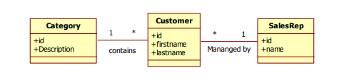
Category ➔ Read Only
Category are never updated
SalesRep ➔ Non Strict Read Write
Seldom change, stale records are fine
Customer ➔ Not cached
Too many customers and customer are updated frequently
Customer Collection for each category ➔ Read Write
Often used, try to avoid stale data as much as possible
Customer Collection For Each SalesRep➔Not cached
Not used frequently

Slide 60
@Entity @org.hibernate.annotations.Entity(mutable=false) @org.hibernate.annotations.Cache(usage= CacheConcurrencyStrategy.READ_ONLY )
@OneToMany(mappedBy="category") @org.hibernate.annotations.Cache(usage= CacheConcurrencyStrategy.READ_WRITE ) private Set customers = new HashSet();
Analyze SQL
Before changing any fetching strategies
Analyze the sql hibernate uses
Look for things that can actually cause problems
Do not overoptimize, only update real problem areas

Slide 61
Optimization Steps
1. Update Fetching Strategies by:
a) Analyzing SQL used by Hibernate
b) Updating a Fetching Strategy
c) Checking SQL to ensure effectiveness
2. Enable Second Level Caching
Fine-tuning the cache settings in production

Slide 62
Spring Container
Create Application Context
ApplicationContext context= new ClassPathXmlApplicationContext(‘springconfig.xml’)
ApplicationContext context= new FileSystemXmlApplicationContext (‘c:\springconfig.xml’)
Get the bean
context.getBean(“@Id”,ClassName.class)
Bean Declare
<bean id="customerService" class="module2.helloworld.CustomerService" />

Slide 63
Life Cycle Methods
<bean id="customerService" class="module2.helloworld.CustomerService“ init-method=“init” destroy-method=“cleanup” />
Calling order
Constructor➔init-method ➔ other method on called ➔ destroy on context closed
Life Cycle Methods with annotation
@PostConstruct
Public void init(){}
@PreDestroy
Public void cleanup(){}
Need following line in springconfig.xml for executing annotation
<context:annotation-config/>

Slide 64
Different types of Dependency Injection
Constructor injection
Field injection
Property/setter injection
Spring context loader sequence of events
Start reading and processing the configuration
Instantiate all the singleton beans and do all the constructor injections
Field and property injection happen here
All init methods (or a method annotated with @PostConstruct) will called
Application will run for a while
Once context.close() is called and before spring application shut down, it will call all the @PreDestroy methods
Can singleton bean be lazy➔yes

Slide 65
Dependency Injection
Inversion of control
Hollywood principle
Framework has control over your code
Ways to wire two objects
Instantiate an object directly
Hard code. Need change in code if you want to switch
Use an interface
Still hard coded those we have flexibility to switch
Use a factory object
Still hard code in factory method even though the factory create the object
Use a spring dependency injection
Attributes are configured in xml and switching requires changes in xml not in code

Slide 66
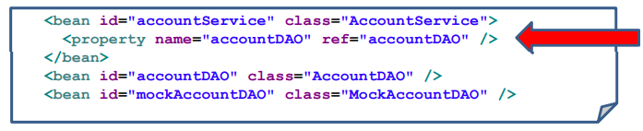
How does DI works
Spring instantiates all beans in the xml configuration file
Spring then connects the attributes to Class instance
Advantages of DI
Easy to change the wiring between objects without changing code
Unit testing become easier
Code is clean
When do we use DI?
When you want to plugin another implementation
When an object references a plumbing objects
As object that send an email
DAO object
When an object references to resources
DB connection

Slide 67
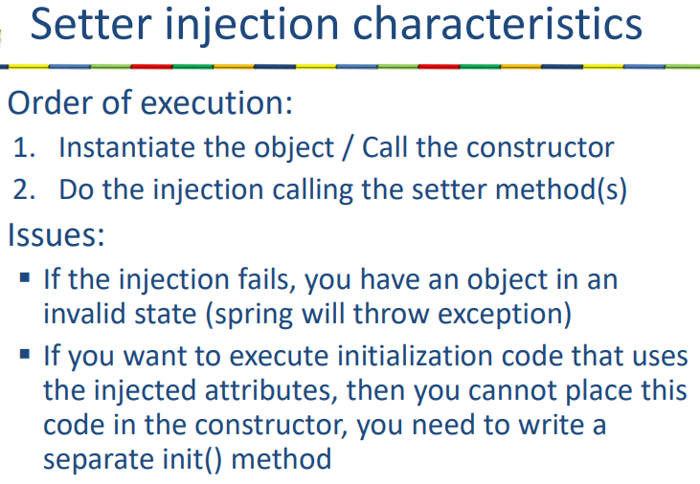
Type of DI
Property Injection
Field Injection
Constructor Injection
Autowiring
XML
Annotations
Setter/Property Injection ➔ need setter method as:
setAccountDAO(IAccountDAO accountDAO){}
<bean id="accountService" class="AccountService">
<property name="accountDAO" ref="accountDAO" />
</bean>
<bean id="accountDAO" class="AccountDAO" />

Slide 68
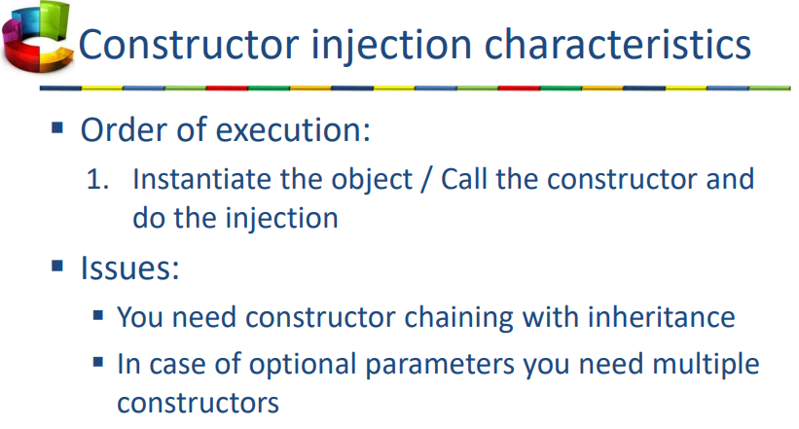
Constructor Injection ➔ need constructor as
Public AccountService(IAccountDAO accountDAO){}
<bean id="accountService" class="AccountService">
<constructor-arg ref="accountDAO" />
</bean>
<bean id="accountDAO" class="AccountDAO" />
Constructor Injection with multiple parameters

Slide 69
Autowiring
3 Types of XML or Annotation Autowiring
By Name
By Type
By Constructor
Autowire by Name
Uses setter injection
Pubic void setEmailService(EmailService emailService){}
<bean id="customerService" class="mypackage.CustomerService" autowire="byName"/>
<bean id="emailService" class="mypackage.EmailService"/>
@Autowired
@Qualifier(“myEmailService”)
Private EmailService emailService;
Need tag, <context:annotation-config/> ➔in xml

Slide 70
Autowiring by Type ➔uses setter injection
Uses setter injection
Pubic void setEmailService(EmailService emailService){}
<bean id="customerService" class="mypackage.CustomerService" autowire="byType"/>
<bean id=“eService" class="mypackage.EmailService"/>
@Autowired
Private EmailService emailService;
Need tag, <context:annotation-config/> ➔in xml

Slide 71
Constructor Autowiring
<bean id="customerService" class="mypackage.CustomerService" autowire="constructor"/>
<bean id="eService" class="mypackage.EmailService"/>
@Autowired
Public CustomerService(EmailService emailService){}
Annotation based Autowiring with JSR-250 annotations
@Resource(name=“myEmailService”)
Private EmailService emailService;

Slide 72
Autowiring
Adv
Make configuration of bean wiring simpler
Dis
The spring xml file does not contain all the explicit details on how the beans are wired together
Autowire by type gives the restriction that you can have only 1 bean of the given type
@Resource and @Inject of JSR are identical to @Autowired
Additional Injection Features
Spring can also inject
Value (optionally based on expressions) <bean id="customerService" class="module3.spel.xml.CustomerService" >
<property name="region" value="English" />
<property name="defaultdiscount" value="4.5" />
</bean>
Collections (Lists, Sets, Maps)
Inheritance (Parent class values)

Slide 73
Value Injection
Xml Based
<bean id="customerService" class="module3.spel.xml.CustomerService" >
<property name="region" value="English" />
<property name="defaultDiscount" value="4.5" />
</bean>
Annotation based
@Value(“English”)
Private String region;
@Value(“4.5”)
Private double defaultDiscount;

Slide 74
Spring expression Language (SPEL)
Looks like JSF expression language
#{ systemProperties['user.language'] }
<bean id="customerService" class="module3.spel.xml.CustomerService" >
<property name="region" value="#{ systemProperties['user.language'] }" />
<property name="defaultdiscount" value="#{ discountCalculator.defaultdiscount }" />
</bean>
<bean id="discountCalculator" class="module3.spel.xml.DiscountCalculator" >
<property name="defaultdiscount" value="0.15" />
</bean>
Annotation based configuration
public class CustomerService implements ICustomerService{
@Value("#{ systemProperties['user.language'] }" )
private String region;
@Value("#{ discountCalculator.defaultdiscount }" )
private double defaultdiscount;
}

Slide 75
Injection of Lists
<bean id="shippingService" class="shipping.ShippingService" >
<constructor-arg>
<list>
<bean id="upsShipper" class="shipping.UPS" />
<bean id="uspostalShipper" class="shipping.USPostal" />
</list>
</constructor-arg>
</bean>
public class ShippingService implements IShippingService{
public List<IShipper> shippers;
public ShippingService(List<IShipper> shippers) {
this.shippers = shippers;
}
}

Slide 76
Injection of a Set
<bean id="shippingService" class="shipping.ShippingService" >
<constructor-arg>
<set>
<bean id="upsShipper" class="shipping.UPS" />
<bean id="uspostalShipper" class="shipping.USPostal" />
<bean id="dhlShipper" class="shipping.DHL" />
</set>
</constructor-arg>
</bean>
Injection of a Map
<bean id="shippingService" class="shipping.ShippingService" >
<constructor-arg>
<map>
<entry key="one" value-ref="upsShipper"/>
<entry key="two" value-ref="uspostalShipper"/>
<entry key="three" value-ref="dhlShipper"/>
</map>
</constructor-arg>
</bean>
<bean id="upsShipper" class="shipping.UPS" />
<bean id="uspostalShipper" class="shipping.USPostal" />
<bean id="dhlShipper" class="shipping.DHL" />

Slide 77
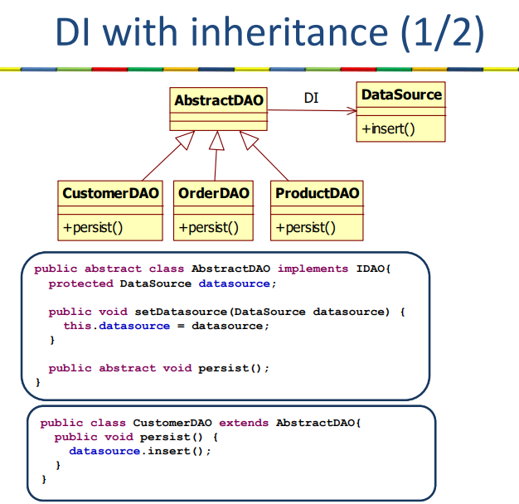
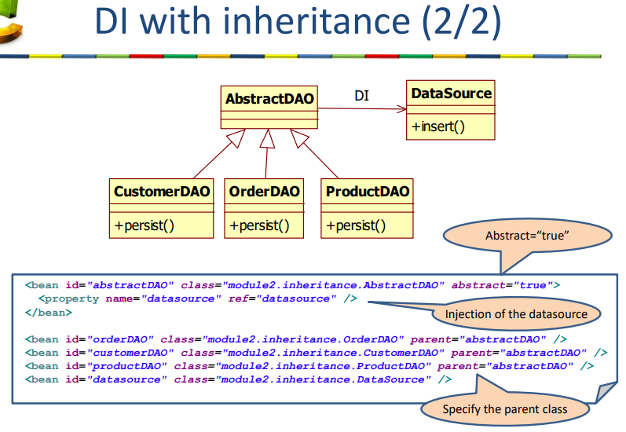

Slide 78
Alternate Configuration Styles
Configure beans through annotations (Classpath scanning)
All classes with the annotations
@Component
@Service
@Repository
@Controller
Configure beans via Java Code

Slide 79
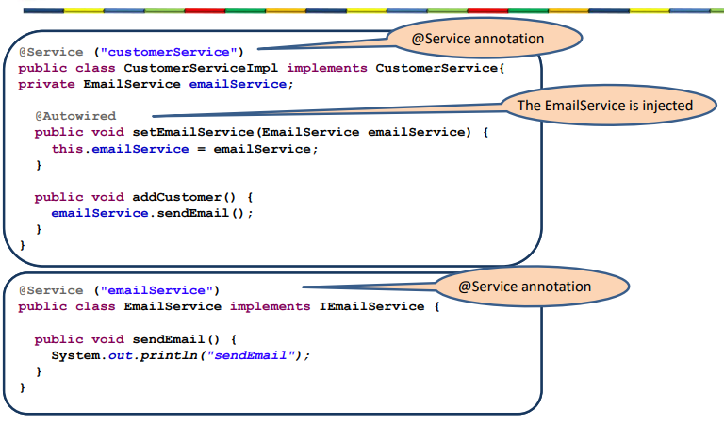
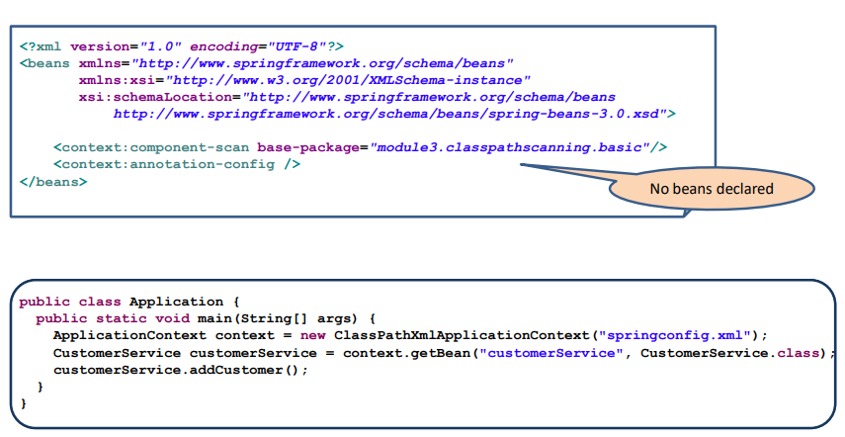
Classpath Scanning
<context:component-scan base-package="module3.classpathscanning.basic"/>
<context:annotation-config />
@Service (“emailService”)
@Scope(“prototype”) ➔default scope is singleton
@lazy(true)

Slide 80
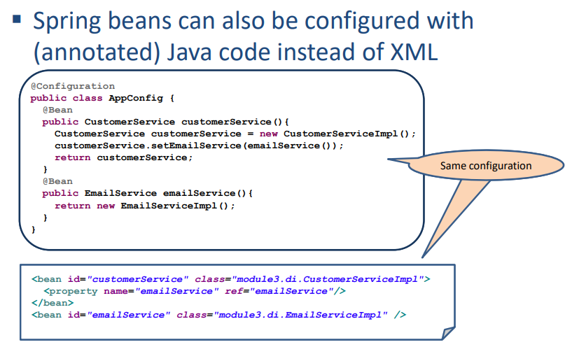
Java Configuration

Slide 81
Xml Configuration
Advantages
Configuration separate from Java code
All configuration in one place
Tools can use the XML for graphical views
Disadvantages
Large verbose XML file(s)
No compile time type safety
Less refactor-friendly
Classpath scanning
Advantages
All information (configuration and logic) in one place: the Java code
More type safe
Disadvantage
Configuration in the Java code
Java Configuration
Advantages
Configuration separate from Java code
Type safe
Disadvantage
Requires a bit more code

Slide 82
Disadvantage of setter based DI
No Guarantee: In Setter based DI, there is no guarantee that a certain dependency is injected or not. We may have an object with partial or no dependency. Whereas in Constructor based DI, an object in not created till the time all the dependencies are ready.
Security: One can use Setter based DI to override another dependency. This can cause Security breach in a Spring application.
Circular Dependency: Setter based DI can cause circular dependency between objects. Where as Constructor based DI will throw ObjectCurrentlyInCreationException if there is a circular dependency during the creation of an object.

Slide 83
Why is annotation configuration called ‘classpath scanning’?
A Classpath scanning basically means, detecting the classes that need to be managed by the Spring under a specified package. You need to make use of the spring @ComponentScan annotation with the @Configuration for classpath scanning. This annotation allows you to specify a base package and also a filter if needed to fine control the package scanning. We will look into both the approaches in this article.

Slide 84
Service Layer
Separation of Concern
Presentation➔service➔business➔integration➔DAO
How does the service layer support the concept of separation of concerns?
Service layer manages the core business logic and total segregated from Domain layer as well as from Persistence layer
Multiple xml configuration file
Via application context
Via using include in xml
Via @Import

Slide 85
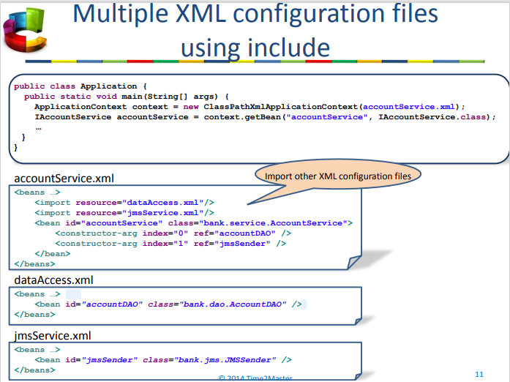
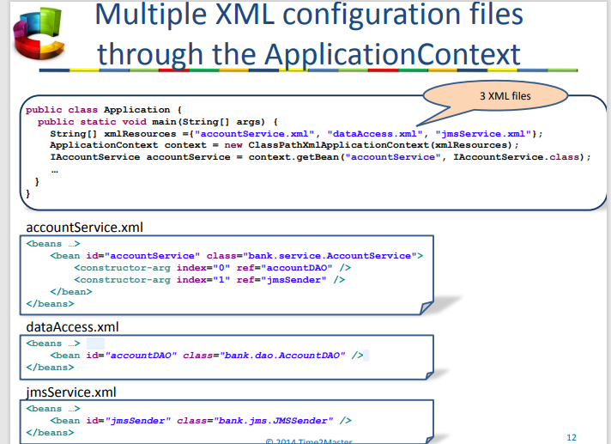
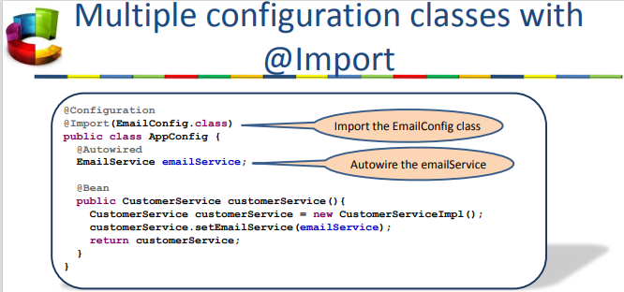

Slide 86
Spring AOP
It is all about separation of concern
adv
Concerns that were previous tangled together are separated into different layers
Eg. Security, logging, email, and so on
It allows us to enjoy greater efficiency and accomplish more by keeping our code simpler and organized
Good programming practice
DRY principle: Do not repeat your self
SOC:
Separate business logic from technical plumbing code
Avoid code tangling
Eg. Of cross cutting concerns
Tracing
Logging
Transactions
Securities, and so on

Slide 87
AOP Concept
JoinPoint
Specific points in the code
PointCut
A collection of 1 or more joinpoints
Aspect
What cross cutting concern do I execute (=advice) at which locations in the code (=pointcut)
Aspect is a application of advice to the point cuts
Advice
Implementation of cross cutting concern
Five types of advices are
Before
After
After returning
After throwing
Around
Weaving
Weaving the advice code together with the target code at the corresponding pointcuts such that we get the correct execution
Proxy based weaving
Load time weaving

Slide 88
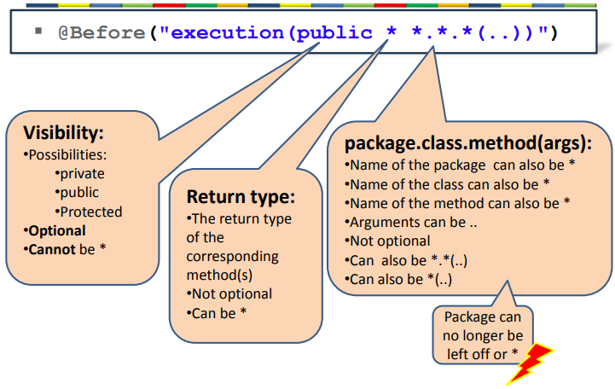
@Aspect
@Before("execution(* accountpackage.AccountService.*(..))")
@After("execution(* accountpackage.AccountService.*(..))")
<aop:aspectj-autoproxy/>
Point Cut Execution Language
"execution(* accountpackage.AccountService.*(..))"

Slide 89
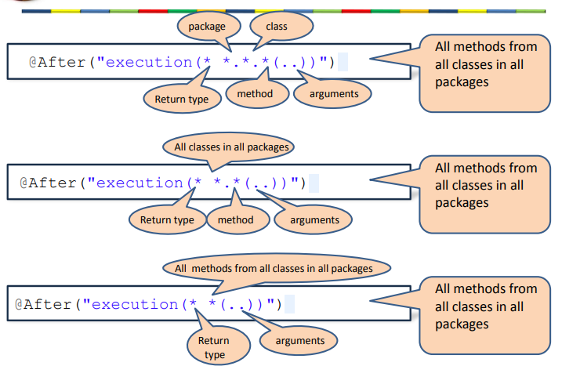
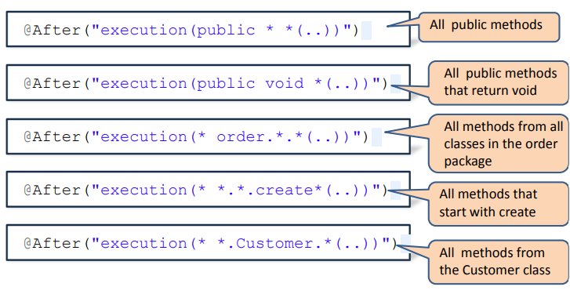
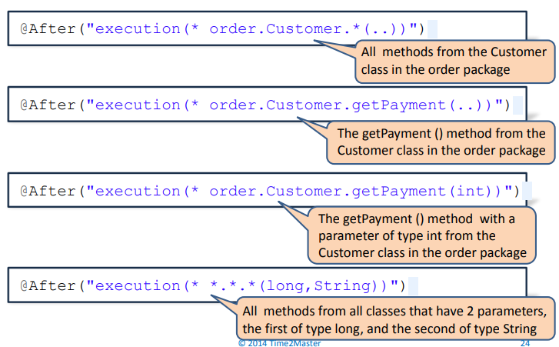
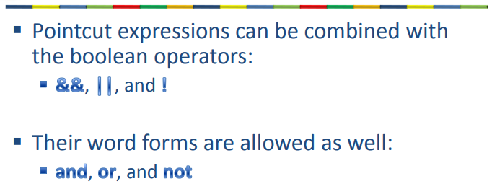

Slide 90
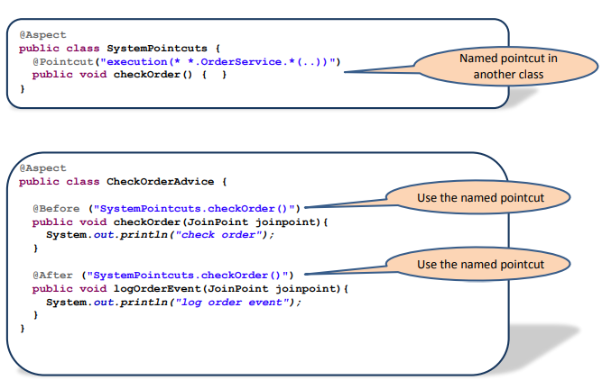
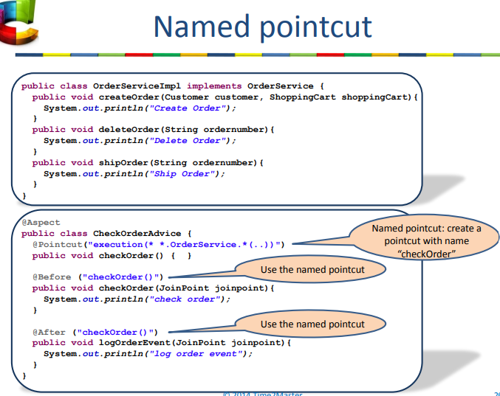
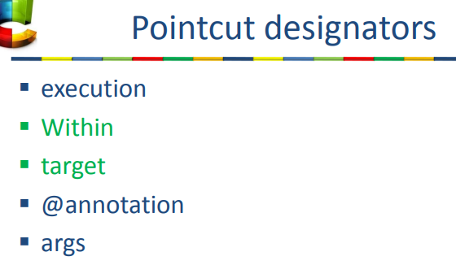

Slide 91
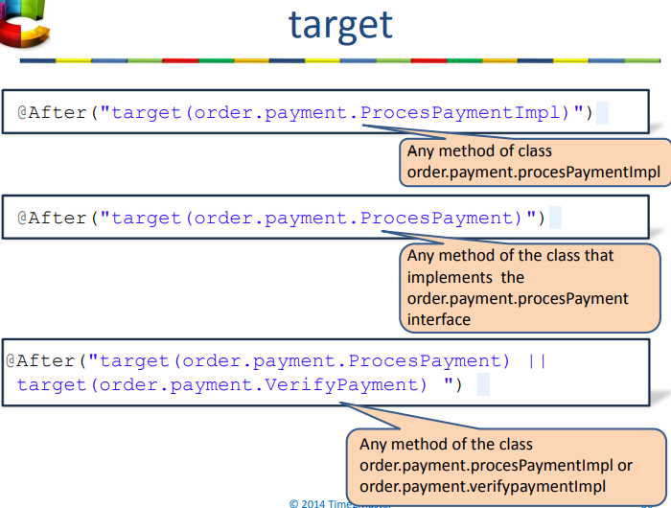
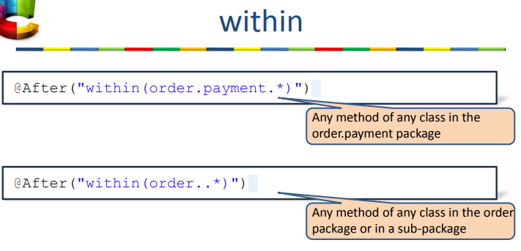
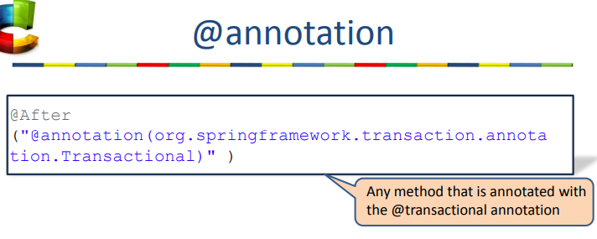
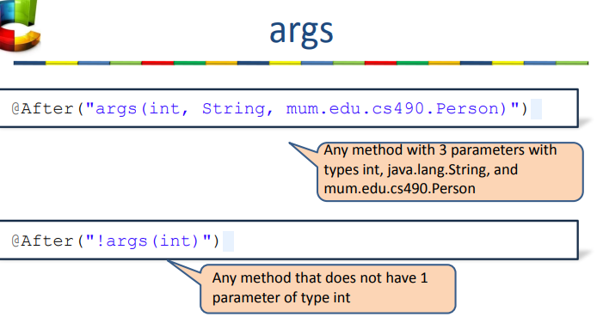

Slide 92
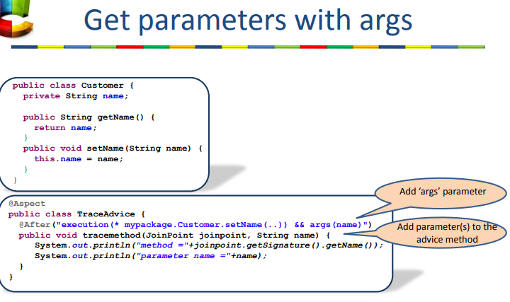
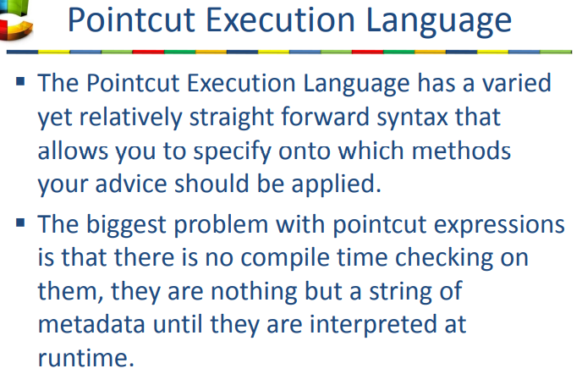

Slide 93
Different Type of Advices
Before
First call the advice method then business logic method
After
First call the business logic then call advice method
After returning
First call business method and when this method returns normal then call advice
After throwing
First call business method and when this method returns exception then call advice
Around
First call the advice method, advice calls the business logic, and business logic returns, we get back to the advice method

Slide 94
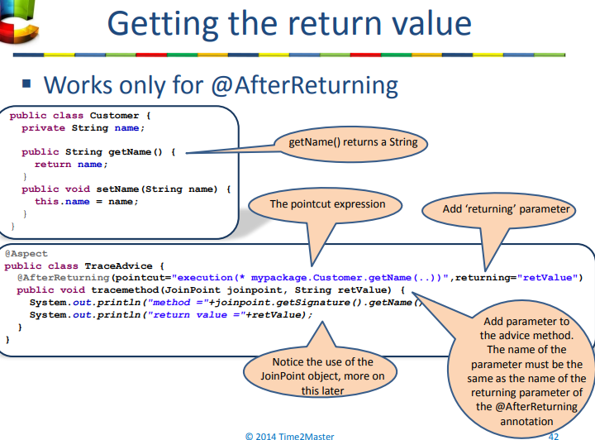
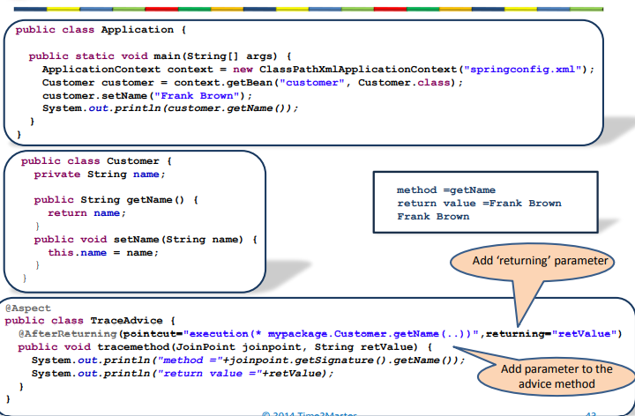

Slide 95
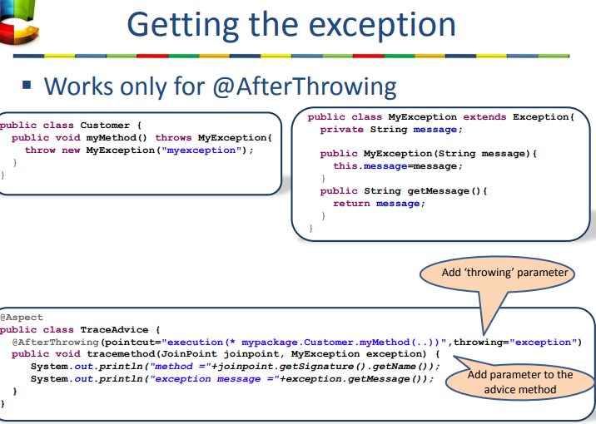
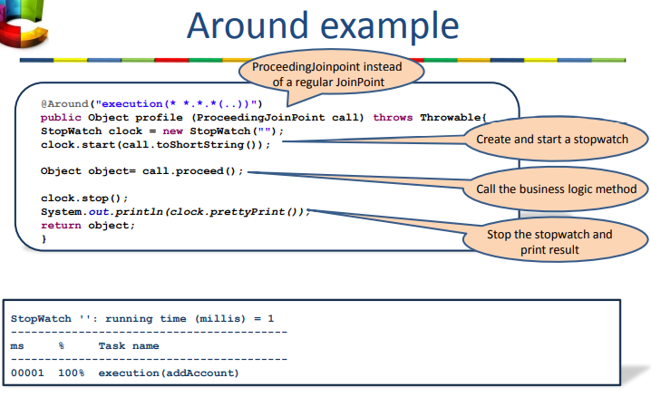

Slide 96
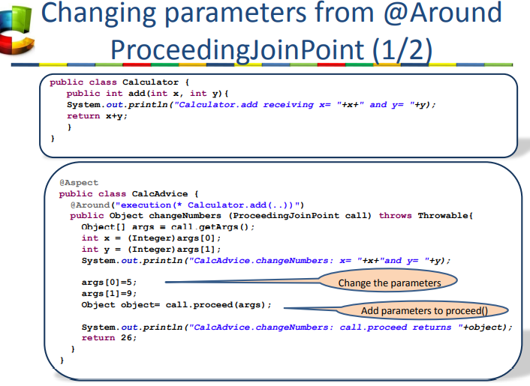
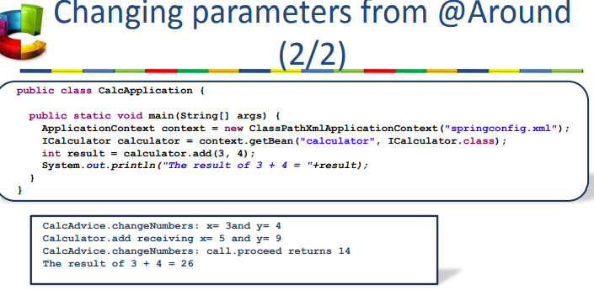
Get parameters from a regular joinpoint
Object[] args = joinpoint.getArgs();
String name = (String)args[0];
int age = (Integer)args[1];

Slide 97
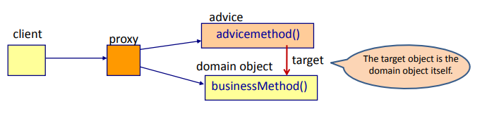
The target class
Customer customer = (Customer)joinpoint.getTarget()

Slide 98
Proxying mechanisms
JDK Dynamic proxy
Target has to implement interface
Used to be preferred
CGLIB sub-class proxy
Constructor will be called twice
<aop:aspectj-autoproxy proxy-target-class="true"/>
Advantages of AOP
No code tangling
No code scattering
Disadvantages of AOP
No clear overview of which code runs when
Pointcut expression is a string and is parsed at runtime
One can make mistake easily
Problems with proxy-based AOP

Slide 99
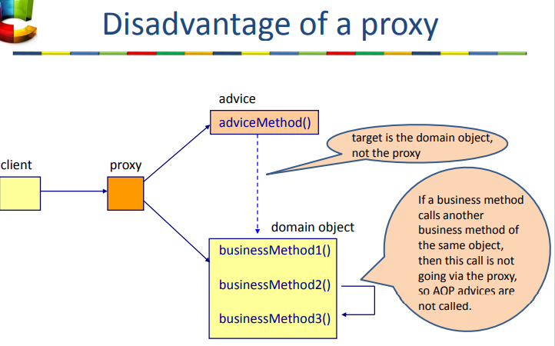
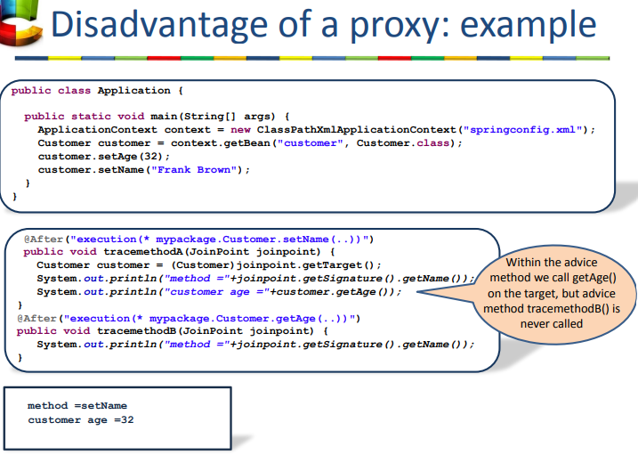
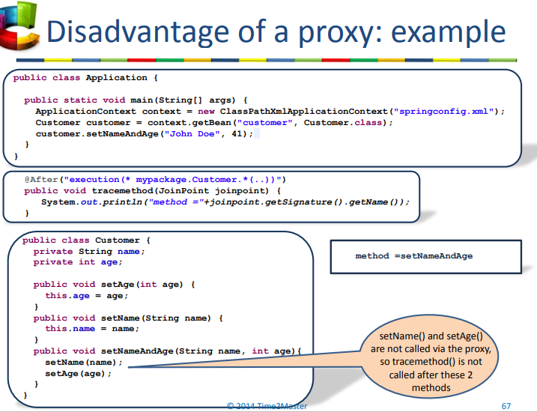
Disadvantages of Proxy
-call another method from within the advice so that proxy advice is never called

Slide 100
Disadvantages of AOP
Difficult to know what runs when
point cut expression are Not compiled time checked
Proxy based AOP has its limitation
What is a pointcut expression?
What is a JoinPoint object? How does it differ from a ProceedingJoinPoint?
ProceedingJoinPoint is an extension of JoinPoint with features of proceed.

Slide 101
Hibernate Application
Use HibernateUtils
Singleton session factory
Avoid session per operation by
Thread Local / Current Session Pattern
Open Session in View Pattern
Session Per Request (from the brower)

Slide 102
Hibernate will most likely be used in DAOs
Starts the SessionFactory everytime
Takes lots of time
Create session factory singleton
Open close the session/Tx every time
Session Per Operation Anti-Pattern
Non Transactional ( not atomic ) behavior
Thread local pattern
Thread local link session to the transaction
Session is closed in view
Open session in view pattern

Slide 103
Using Singleton SessionFactory in DAO (called Session-per-Operation anti pattern)
1. Code Problems
Lots of nearly indentical code in DAO methods
Essentially just copy / pasted
2. Session Problems
DAO open and close a session per operation
Session cache is never used
Retrieved objects are immediately detached
No ways to automatically load related entities
Need to separately load enttiies
Not doing so will create Lazy initialization problems
3. Transaction Problems
Transaction only span a single operation
Transaction never span a unit of work
Essentially creating non-transactional behavior
4. Exception Problems
Exception is handled in the lowest layer
Thus users are left in dark
Exception is supposed to be handled best in the control layer
So that it allows controller to choose different views

Slide 104
Thread local session pattern
One solution
Create session in controller and pass it to every method call but this could make Hibernate tight coupling with controller
Next solution is use the “Current Session”
thread provided by Hibernate so that we do not have to pass the session around
Scope of the “Current Session”
Any sequential call returns the same session
On commit the session is flushed and closed automatically
Transaction and scope have roughly the same scope
Unit of Work
Create transactions that span a unit of work by using hibernateUtils and the Thread Local
Reason to eager load
Controller does not call the view
All data needed by the view has to be loaded before access to the session is finished
Two kinds of eager loading
Always eager join mapping
Eager join fetch queries
Third form of eager loading is
Hibernate.initialize(…..);

Slide 105
Open Session in View Pattern
Filter
Added in View Layer
Filter helps to keep the session open during the execution of the controller
Open the transaction before the controller begins and closes it after the view finishes
Result
Service methods
No longer contains Hibernate.Initialize()
No longer contains TX code
DAO
Same DAO as used in Thread Local Pattern
Controller
No longer catches the exception
Roll back the transactions or redirects to the error page
Issues in Open Session
Transactions can span too many operations (no longer atomic)
Solution: spring – Hibernate integration

Slide 106



Slide 107
Spring and Hibernate
Combined features
One config file for both Spring and Hibernate
SessionFactory becomes a Spring bean singleton
Project can then use full spring feature set like DI, AOP, Spring Templates
No longer need HibernateUtils
SessionFactory is created by Spring on startup
SessionFactory can be easily be retrieved from Spring

Slide 108
Declarative Transaction (CMT)
Helps to solve our Transaction Issues
Spring is not a transaction Manager
We still need a transaction manager
JDBC transaction manager
Hibernate transaction manager
XA transaction manager (JTA)
Because of the OpenSessionInView filter our transaction was demarcated in the UI layer thus making it possible to span more than one unit of work
Spring transactions
Lets you specify that service level methods should always execute in their own transaction
Thus ensuring transactions only span a single UOW
Specify that DAO methods always already expect an existing transaction
Ensuring that they are never called without transaction
@Transactional(propagation=Propagation.REQUIRES_NEW, readOnly=true)
@ Transactional(propagation=Propagation.MANDATORY)

Slide 109



Slide 110
Spring Transactions
A Transaction is a unit of work (ACID)
Atomic: considered as a single unit that is either the entire success or entire fail
Consistency: from one consistent state to another consistent state
Isolated: Data in transaction cannot be changed from another concurrent processes
Durable: Once committed changes are persistent
Transaction Choices
Local or global transaction ➔ Do not use global transactions
Transaction Isolation Level
Transaction Propagation

Slide 111
Local Transactions
Use a single transactional resources (database, message bus)
Transactions are managed by DB and hence they are simple and fast
Global Transactions
Transactions that span or access multiple transactional resources
Such as databases
More common in enterprise applications
Also called XA transactions (that is single transaction accessing multiple resources)
XA transaction is also called two phase commit protocol that is natively support by many databases
Transaction Manager
Global transactions have to be managed on the application side to coordinate resources which is done by transaction manager
Is a standard java Transaction API (JTA) interface
Is a part of Java EE application server
2 Phase commit (success)
2 Phase commit (failure)

Slide 112
Characteristics of XA transactions
2 phase commit
Does not guarantee that nothing can go wrong
Is slow – multiple remote connections
Transactional resources become dependent on each other
Need to keep lock until ALL resources are finished
Thus decreasing performance
Isolation Levels
Proper full isolation level is expensive to product
Isolation is often relaxed to increase db speed
ANSI SQL defines four isolation levels
Read uncommit → read commit ➔Repeatable Read ➔ serializable
Weaker, faster ➔ stronger, slower
Most DB default to Read Committed
Only serializable fully isolates a transaction from concurrency issues

Slide 113


Slide 114
Read Uncommitted
Transactions can read uncommitted updates made by other transactions
Violates ACID properties
Not supported by many database vendors
Do not use this level of isolation in a multithread system
Read Committed
Allow multiple transactions to access the same data but hides non-committed data from other transactions
Default setting for most DB
Some delays caused by write locks
Unrepeatable reads problems
Isolation Loss
Read committed can read data that is newly committed during the transactions can cause
Unrepeatable read: If a row is read twice during a transaction, the second read might give different data because of concurrent updates
Phantom Read: if the same select is executed twice then second query can give more result
Repeatable Read
Once a value is read within a transaction, all sub-sequent reads will return the same result. This is done by maintain additional read lock on top of previous lock
Read both read and write locks for the duration of the transaction
Can still get phantom read (insertion) problems

Slide 115
Serializable
Ensures complete isolation from change, as if all transactions were executed in a serial manner
Concurrent reads are still possible
Many locks means low performance
Due to many locks there is more changes of deadlocks
Transaction Propagation
Defines interaction between transactions and method calls
Goal of TX is to make atomicity in global transactions
Normally any method called between a begintransaction() and commit() is part of TX
A TX created for transferFunds() will automatically propagates to both withdraw() and deposit()
Types of propagation options
REQUIRED
REQUIRED_NEW
MANDATORY
NESTED
SUPPORTS
NOT_SUPPORTED
NEVER

Slide 116
Propagation: REQUIRED
If the calling methods M1() runs in a Transaction T1 then method M2() joins the same transaction T1
If the calling methods M1() does not run in a Transaction then method M2() runs in a new created transaction T1
Propagation: REQUIRES_NEW (More problematic as T1 is suspended on calling)
If the calling methods M1() runs in a Transaction T1 then method M2() runs in a new transaction T2
If the calling methods M1() does not run in a Transaction then method M2() runs in a new created transaction T1
Propagation: MANDATORY
If the calling method m1() runs in a transaction T1, then method m2() joins the same transaction T1
If the calling method m1() does not run in a transaction , an exception is thrown

Slide 117
Propagation NESTED (More Problematic)
If the calling method M1() runs in a transaction T1, then method M2() runs in a nested transaction T2
If the calling method m1() does not run in a transaction , then method m2() runs in a new created transaction T1
Propagation: SUPPORTS
If the calling method m1() runs in a transaction T1, then method m2() joins the same transaction T1
If the calling method m1() does not run in a transaction , then method m2() also does not run within a transaction
Propagation: NOT_SUPPORTS (More problematic as T1 is suspended on calling)
If the calling method m1() runs in a transaction T1, then method m2() does not run within a transaction.
If the calling method m1() does not run in a transaction , then method m2() also does not run within a transaction

Slide 118
Propagation: NEVER
If the calling method m1() runs in a transaction T1, an exception is thrown
If the calling method m1() does not run in a transaction , then method m2() also does not run within a transaction
Notes:
Default propagation is
Propagation: REQUIRED
Propogation options that require suspension or nesting are more problematic

Slide 119
Spring Transaction Support
Spring is not a transaction manager and hence its still requires a Transaction Manager
JDBC transaction manager
Hibernate transaction manager
XA transaction manager (JTA)
Spring provides an abstraction for transaction management
That is, you define how the transactions should be managed
Spring works with the underlying transaction manager
Transaction Demarcation
Is a specification of the transactional boundaries
Is typically available at the service level
Multiple DAO can be involved in one transaction
Creating a transaction per unit of work

Slide 120
Spring Declarative Demarcation
Just declare @Transactional(propagation=Propagation.REQUIRED, isolation=Isolation.READ_COMMITTED) ➔isolation is optional
Spring will take care of opening and closing the transaction
Transaction propagates to called methods as normal
Declare @Transactional(propagation=Propagation.REQUIRED, isolation=Isolation.READ_COMMITTED) in call methods too
Can be declared in class level
Can override the declaration at function level as
@Transactional(propagation=Propagation.SUPPORTS)
Need following in springconfig.xml
<tx:annotation-driven transaction-manager="txManager"/>
<bean id="txManager" class="org.springframework.orm.hibernate3.HibernateTransactionManager">
<property name="sessionFactory" ref="sessionFactory" />
</bean>
Read only ➔ @Transactional(readOnly=true)
Timeout ➔ @Transactional(timeout=10)
Rollback ➔ @Transactional( rollbackFor={MyCheckedException.class}, noRollbackFor={MyRuntimeException.class} )

Slide 121
Define: transaction demarcation
Transaction demarcation always wraps a sequence of actions, such as a single request, a single method, or a section of code within a method. The demarcation initializes some transactional behavior before the demarcated area begins, then ends that transactional behavior when the demarcated area ends.
Define: Transaction propagation
Transaction Propagation indicates if any component or service will or will not participate in transaction and how will it behave if the calling component/service already has or does not have a transaction created already.

Slide 122
Spring scheduling
Scheduling technologies
JDK’s java.util.Timer & Java.utul.concurrency schedular
Basic scheduling support
Execute at given time
Execute at some fix frequency
Quartz scheduling
Well established open source framework
Powerful job scheduling
Cron-based scheduling
Spring support for job scheduling

Slide 123
Scheduling Terminologies
Job/Task
Trigger
Schedule (a collection of triggers)
CRON expressions
Will match one or more instances in time
String with 6 to 7 spaces separated sub-expression
seconds minutes hours dayOfMonth month dayOfWeek year(optional)
0 30 12 * * MON-FRI

Slide 124
JDK timer
Timer timer = new Timer();
timer.scheduleAtFixedRate(new HelloWorldTask(), 5000, 5000);
Java 5 does not require sub-classing TimerTask
ScheduledExecutorService tpool = Executors.newScheduledThreadPool(5);
HelloWorldTask task = new HelloWorldTask();
// executes 5 seconds after being called (does not repeat)
tpool.schedule(task, 5, TimeUnit.SECONDS);
Quartz Simple Scheduling
Scheduler scheduler =new StdSchedulerFactory().getScheduler();
scheduler.start();
JobDetail jobDetail=new JobDetail("HelloWorldJob",scheduler.DEFAULT_GROUP,HelloWorldJob.class);
Trigger simpleTrigger=new SimpleTrigger("mytrigger",scheduler.DEFAULT_GROUP,new Date(),null,SimpleTrigger.REPEAT_INDEFINITELY,5000);
scheduler.scheduleJob(jobDetail, simpleTrigger);

Slide 125
Quartz Cron scheduling
Scheduler scheduler =new StdSchedulerFactory().getScheduler();
scheduler.start();
JobDetail jobDetail=new JobDetail("HelloWorldJob",scheduler.DEFAULT_GROUP,HelloWorldJob.class);
String cronExpression ="0/5 * * * * ?";
Trigger crontrigger=new CronTrigger("crontrigger",scheduler.DEFAULT_GROUP,cronExpression);
scheduler.scheduleJob(jobDetail, crontrigger);

Slide 126
Scheduling with Spring
Spring annotation
FixedRate, FixedDelay, or Cron
Annotate any method on any POJO
Should not take any params
Should return void
Ex.
@Scheduled(fixedRate = 5000, initialDelay = 1000)
public void fixedRateMethod() { System.out.println("Fixed rate"); }
Spring config
<task:annotation-driven scheduler="myScheduler" /> ➔Looks for @Scheduled
<task:scheduler id="myScheduler" pool-size="10" /> ➔Scheduling Thread Pool

Slide 127
Async Method Calls
Not wait for a return
The method is started in a separate thread so that the application does not have to wait
@Async
public void longRunningMethod()
{
Thread.sleep(5000);
System.out.println("Finished longRunningMethod");
}
<task:annotation-driven executor="myExecutor" /> ➔Look for @Async
<task:executor id="myExecutor" pool-size="5" /> ➔Executor thread pool size

Slide 128
Write a Cron Trigger that has a delay of 30 seconds, and then fires every 10 seconds, Friday afternoon at 2:45pm
What if we want it to start at 2:45pm and continue firing every 10 seconds until 2:50pm?

Slide 129
Why does session factory is singleton?
Session factory is very heavy and may impact performance.
Issues with Session/Operation Anti-pattern
We lose the maximum benefit of caching
You can only have one transaction per operation (no unit of work)
Code problem. Session open/close and transaction start/commit needs to be repeated many time unnecessarily
Exception problem. We are catching the exception at the lowest layer of the application (data access layer)
How do we solve the session/operation anti-pattern?
By applying the Hibernate ThreadLocal/Current Session Pattern
What happens when you call sessionFactory.getCurrentSession() with ThreadLocal pattern?
Hibernate will load the current session (will create one if it does not exist) from the ThreadLocal. As a result each thread gets its own session. In this case (and only in this case) hibernate closes the session when you tx.commit()
What is the one issue that still remains?
After you close the session (in the controller or service layer) if you try to access lazy-loaded data in JPA entities you get the lazy-initialization exception. This is normally in context of web application.
How do we solve that?
Open-Session-in-View Filter
Hibernate.initialize()
Eager loading of everything()
In spring-hibernate
You can have multiple transaction within same

